Slide 1
Department of Computer Science & Engineering
A REAL TIME RESEARCH PROJECT
ON
AUTOMATED CONTROL SYSTEM FOR AIR POLLUTION DETECTION IN VEHICLES
PRESENTED BY
K.AKANKSHA (247R1A05V1)
K.KARTHIK (257R5A0531)
UNDER THE GUIDENCE
Mrs. B. Pooja
ASSISTANT PROFESSOR
BATCH NO: E-10

Slide 2
TABLE OF CONTENTS
ABSTRACT
INTRODUCTION
EXSISTING SYSTEM
LIMITAIONS OF EXIXTING SYSTEM
DISADVANTAGES
PROPOSER SYSTEM
ADVANTAGES
SOFTWARE REQUIRMENTS
HARDWARE REQUIREMENTS
NOVELTY OF THE PROJECT
ARCHITECTURE
MODULES
UML DIAGRAMS
RESULT
CONCLUSION
FUTURE ENHANCEMENT
REFERENCE
GITHUD

Slide 3
ABSTRACT
Air pollution from vehicles is a big problem that affects the environment and human health. Harmful gases like carbon monoxide (CO), carbon dioxide (CO₂), and other pollutants are released from vehicle exhausts. These gases increase air pollution and can cause serious health issues.
The Automated Control System for Air Pollution Detection in Vehicles is designed to monitor the pollution produced by vehicles. The system uses gas sensors to detect harmful gases from the vehicle exhaust. The sensor sends the information to a microcontroller that checks whether the pollution level is within the allowed limit.

Slide 4
INTRODUCTION
Air pollution is a serious problem caused mainly by harmful gases released from vehicles. These gases can affect human health and damage the environment. Usually, vehicles are tested for pollution only at testing centers, which may not show the actual pollution produced during daily use. To solve this problem, an Automated Pollution Control System is used. It uses gas sensors to detect harmful gases from vehicle exhaust and sends the data to a controller. The controller checks the pollution level and gives a warning if it exceeds the allowed limit. This system helps in continuous monitoring and reducing air pollution.

Slide 5
EXISTING SYSTEM
Traditional vehicle emission checks rely on periodic manual inspections at service stations or regulatory testing centers, using portable analyzers that sample exhaust gases sporadically. These methods suffer from low frequency, human error, and inability to capture real-time variations during actual driving conditions, often allowing high-polluting vehicles to operate unchecked between tests. Compliance depends on driver initiative, with limited integration into vehicle electronics or broader traffic management systems.​

Slide 6
LIMITATIONS OF EXISITING SYSTEM
Occasional Testing
Inaccurate Results
Manual Monitoring
No Instant Alerts
Increased Air Pollution

Slide 7
DISADVANTAGES
Sensor Accuracy Issues
Maintenance Required
Power Consumption
Limited Gas Detection Range
Dependence on Proper Installation
False Alerts
System Failure Risk

Slide 8
PROPOSED SYSTEM
The proposed system introduces continuous, on-board air quality sensors interfaced with a microcontroller for automated detection and control of emissions directly from vehicles. It features real-time data logging, threshold-based engine control (e.g., reducing fuel injection if pollution exceeds limits), and IoT connectivity for cloud-based analytics, geofencing alerts, and integration with smart city infrastructure. This enhances accuracy, enables predictive maintenance, and supports fleet-wide emission tracking for authorities

Slide 9
ADVANTAGES
Simple system
Low cost
Government regulation
Easy testing process
Identifies high pollution

Slide 10
SOFTWARE REQUIREMENTS
Arduino IDE
Embedded C Programming Language
implementation
Serial Monitor (Arduino IDE Tool)
Libraries for Sensors and LCD

Slide 11
HARDWARE COMPONENTS
Gas Sensor
Arduino (Uno / ESP32)
DHT11 / DHT22 Sensor
9V Battery
Buzzer
Bridge Rectifier (DB107)
Filter Circuit

Slide 12
NOVELITY OF THE PROJECT
Real-Time Emission Monitoring
Automatic Control Mechanism
Embedded System Integration
Threshold-Based Intelligent Detection
Driver Alert System

Slide 13
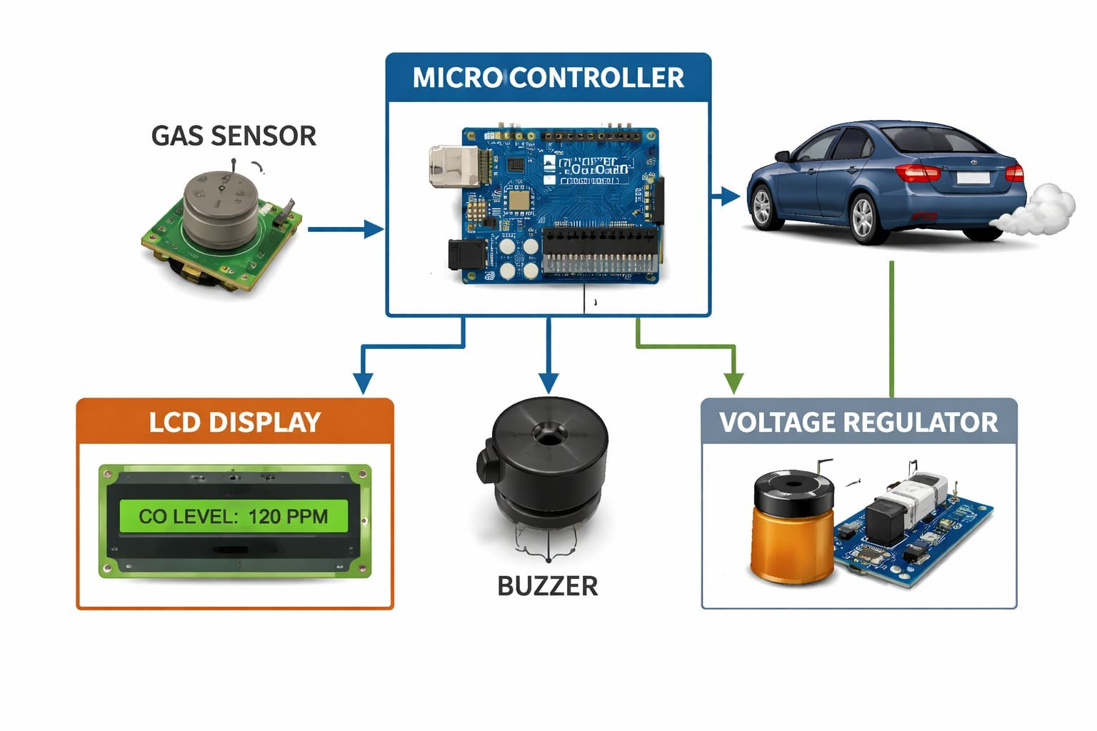
ARCHITECTURE

Slide 14
MODULES
Gas Detection Module
Data Processing Module
Threshold Checking Module
Alert Module
Communication Module

Slide 15
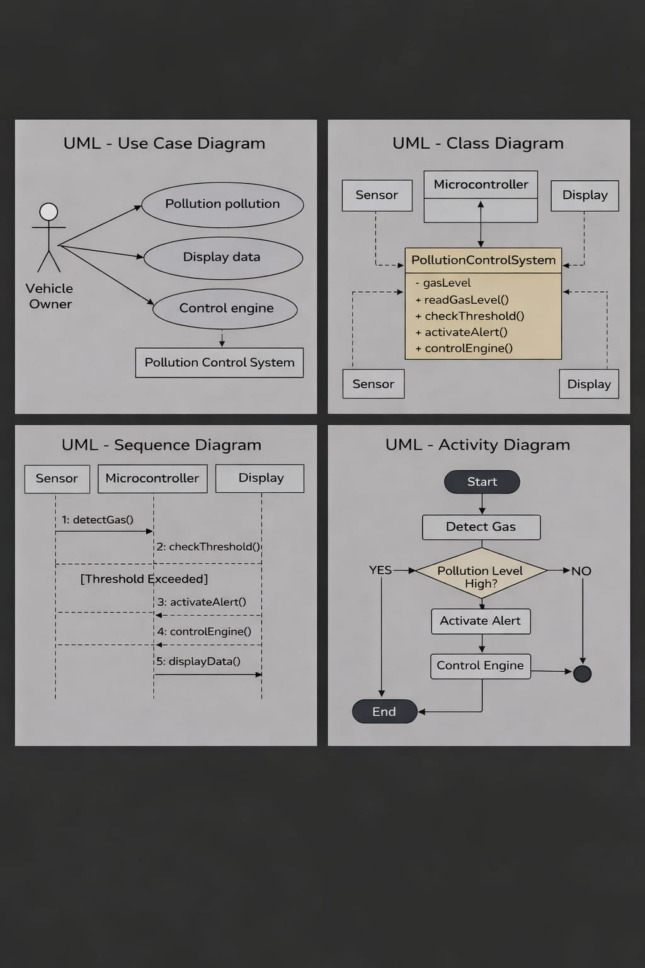
UML-USE CASE DAIGRAM

Slide 16
UML –ACTIVITY DIAGRAM

Slide 17
UML – CLASS DAIGRAM

Slide 18
UML – SEQUENCE DIAGRAM

Slide 19
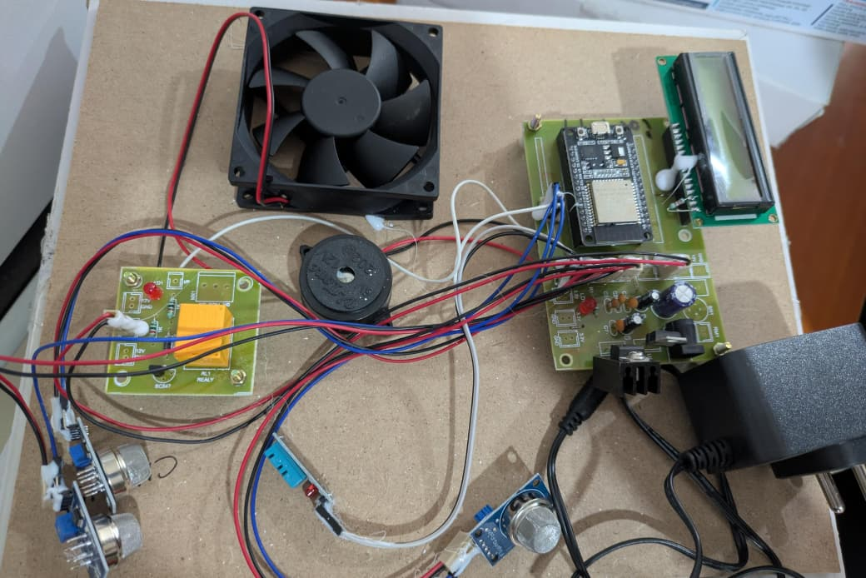
RESULT

Slide 20
CONCLUSION
The Automated Control System for Air Pollution Detection in Vehicles helps monitor vehicle emissions in real time. It uses gas sensors and a microcontroller to detect harmful gases from vehicle exhaust. When the pollution level exceeds the allowed limit, the system sends alerts and stores the data for monitoring. This system helps reduce air pollution, improves environmental safety, and supports better pollution control.

Slide 21
FUTURE ENHACEMENT
IoT-Based Monitoring using ESP Module
Automatic Fan/Exhaust Control System
Multi-Gas Sensor Integration
LCD Display Enhancement for Real-Time Data
Alert System using Buzzer and LED

Slide 22
REFERENCE
Athare, N. & Badadapure, P. R. Automated Control System for Air Pollution Detection in Vehicles. International Journal of Electrical and Electronics Research (2015).
Tiwari, D., Shekhar, S., Joshi, A., & Deep, A. Automated System for Air Pollution Detection and Control in Vehicles. International Journal of Electrical and Electronics Research (2015).
Kadir, S., & Amalia, Z. IoT-based Exhaust Gas Emission Detection System for Motorized Vehicles. International Journal of Frontier Technology and Engineering (2024). DOI:10.33795/ijfte.v3i1.5675.
Ali I. K., Anjali N. R., Anusha V. S., Bhagyashree V. G., & Spoorthi T. S. IoT Based Vehicle Emission Monitoring System. IJIREEICE, DOI:10.17148/IJIREEICE.2025.13806.

Slide 23
GIT HUB
https://github.com/Manojkumar128/Automated-control-system-for-air-pollution-detection-in-vehicles.git

